Slide 1
Linked List
-Single Linked List
-Doubly Linked List
-Practise

Slide 2
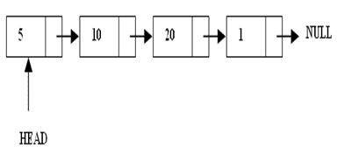
What are Linked Lists
A linked list is a linear data structure.
Nodes make up linked lists.
Nodes are structures made up of data and a pointer to another node.
Usually the pointer is called next.

Slide 3
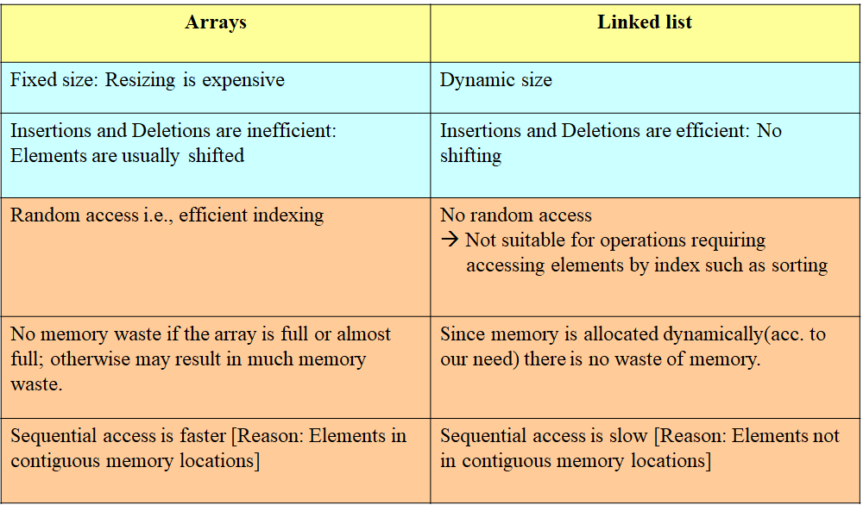
Arrays Vs Linked Lists

Slide 4
Types of lists
There are two basic types of linked list
Singly Linked list
Doubly linked list

Slide 5
Singly Linked List
Each node has only one link part
Each link part contains the address of the next node in the list
Link part of the last node contains NULL value which signifies the end of the node

Slide 6
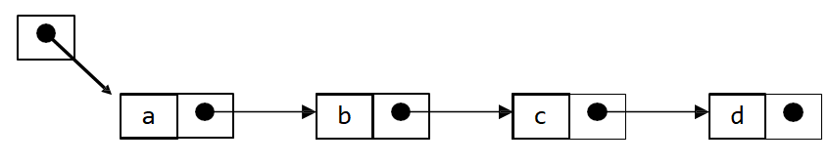
Schematic representation
Here is a singly-linked list (SLL):
myList
•Each node contains a value(data) and a pointer to the next node in the list.
•myList is the header pointer which points at the first node in the list

Slide 7
Basic Operations on a list
•Creating a List
•Inserting an element in a list
•Deleting an element from a list
•Searching a list
•Reversing a list

Slide 8
Creating a node
struct node{
int data;
node* next; // A simple node of linked list
};
node* HEAD=NULL; //HEAD pointing to NULL

Slide 9

Creating Node
node* GetNode(int data) //say num=1 is passed from main
{
node* newNode = new node(); //memory allocated dynamically
if (newNode == NULL) cout<<‘OVERFLOW’; // no memory available
exit(1);
else
{
newNode->data=data; newNode->next=NULL;
return newNode;
}
}

Slide 10
To be called from main() as:-
void main()
{
node* node;
int data;
cout<<”Enter the data to be Inserted”;
cin>>data;
node = GetNode(data);
}

Slide 11
Inserting the node in a SLL
There are 3 cases here:-
ØInsertion at the beginning
ØInsertion at the end
ØInsertion after a particular node

Slide 12
Insertion at the beginning
There are two steps to be followed:-
a)Make the next pointer of the node point towards the first node of the list
b)Make the start pointer point towards this new node
-If the list is empty simply make the start pointer point towards the new node;

Slide 13
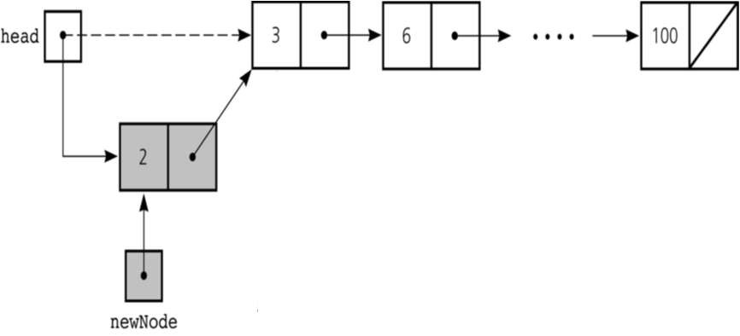

Slide 14
Insert Node at Beginning
void insert_beg(node* p)
{
node* temp;
if (HEAD == NULL){
HEAD = p;
cout<<”\nNode inserted successfully at the beginning”;
}
else {
temp = HEAD;
HEAD = p;
p->next=temp; //making new node point at beginning
}}

Slide 15
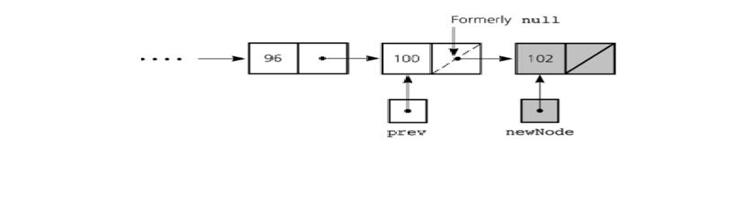
Inserting at the end
Here we simply need to make the next pointer of the last node point to the new node

Slide 16
void insert_end(node* p) {
node* q = HEAD;
if (HEAD == NULL){
HEAD = p;
cout<<”\nNode inserted successfully at the end…!!!\n”;
}
else {
while (q->next != NULL) q=q->next;
q->next = p;
}
}

Slide 17
Inserting after an element
Here we again need to do 2 steps :-
§Make the next pointer of the node to be inserted point to the next node of the node after which you want to insert the node
§Make the next pointer of the node after which the node is to be inserted, point to the node to be inserted

Slide 18
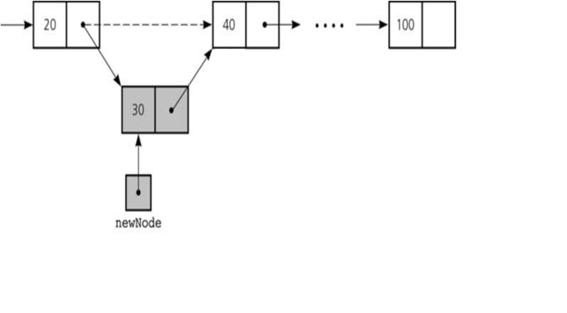

Slide 19
Code for inserting node after an element
void insert_after(int c, node* p)
{
node* q;
q = HEAD;
for(int i=1; i<c; i++){
q = q->next;
if (q == NULL)
cout<<”Less than “<<c<<” nodes in the list…!!!”;
}
p->next = q->next;
q->next = p;
cout<<”\nNode inserted successfully”;
}

Slide 20
Deleting a node in SLL
Here also we have three cases:-
ØDeleting the first node
ØDeleting the last node
ØDeleting the intermediate node

Slide 21
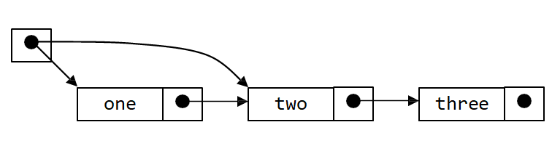
Deleting the first node
Here we apply 2 steps:-
§Making the start pointer point towards the 2nd node
§Deleting the first node using delete keyword
start

Slide 22
void del_first()
{
if(HEAD == NULL)
cout<<”\nError……List is empty\n”;
else {
node* temp = HEAD;
HEAD = temp->next;
delete temp;
cout<<”\nFirst node deleted successfully….!!!”;
}
}

Slide 23
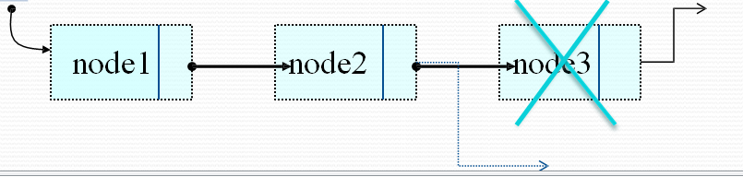
Deleting the last node
Here we apply 2 steps:-
§Making the second last node’s next pointer point to NULL
§Deleting the last node via delete keyword
start

Slide 24
void del_last()
{
if(start==NULL)
cout<<”\nError….List is empty”;
else
{
node* q=start;
while(q->link->link!=NULL)
q=q->link;
node* temp=q->link; q->link=NULL; delete temp;
cout<<”\nDeleted successfully…”;
}
}}

Slide 25
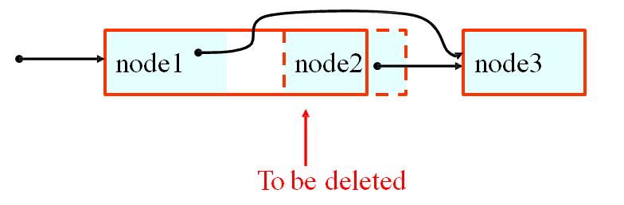
Deleting a particular node
•Here we make the next pointer of the node previous to the node being deleted ,point to the successor node of the node to be deleted and then delete the node using delete keyword

Slide 26
void del(int c)
{
node* q=start;
for(int i=2;i<c;i++)
{
q=q->link;
if(q==NULL)
cout<<”\nNode not found\n”;
}
if(i==c)
{
node* p=q->link;
q->link=p->link;
delete p;
cout<<“Deleted Successfully”;
}
}

Slide 27
Searching a SLL
Searching involves finding the required element in the list
We can use various techniques of searching like linear search or binary search where binary search is more efficient in case of Arrays
But in case of linked list since random access is not available it would become complex to do binary search in it
We can perform simple linear search traversal

Slide 28
In linear search each node is traversed till the data in
the node matches with the required value
void search(int x)
{
node*temp=start; while(temp!=NULL)
{
if(temp->data==x)
{
cout<<“FOUND ”<<temp->data; break;
}
temp=temp->next;
}
}

Slide 29
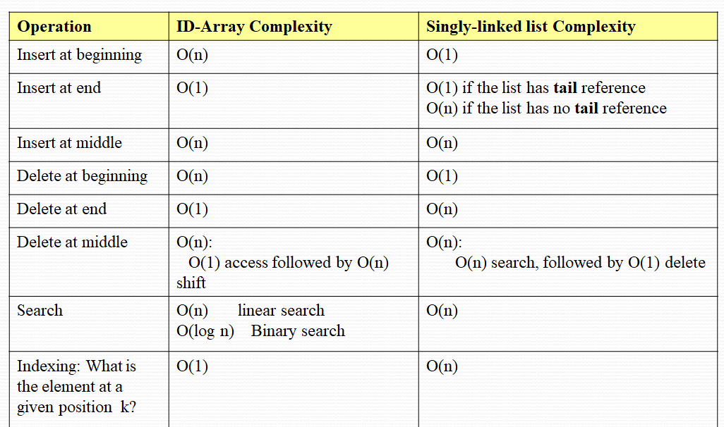
COMPLEXITY OF VARIOUS OPERATIONS IN ARRAYS AND SLL

Slide 30
Doubly Linked List
1. Doubly linked list is a linked data structure that consists of a set of sequentially linked records called nodes.
2.Each node contains three fields ::
-: one is data part which contain data only.
-:two other field is links part that are point or references to the previous or to the next node in the sequence of nodes.
3. The beginning and ending nodes' previous and next links, respectively, point to some kind of terminator, typically a sentinel node or null to facilitate traversal of the list.

Slide 31
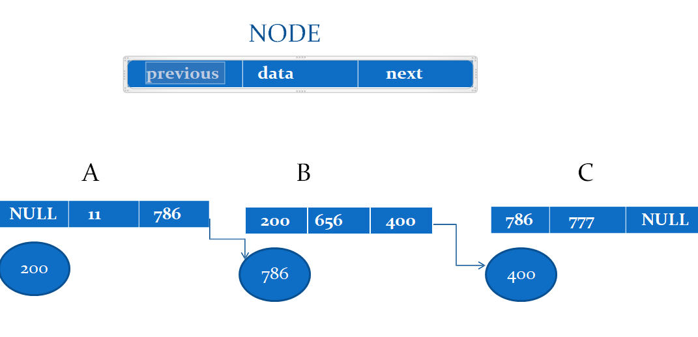
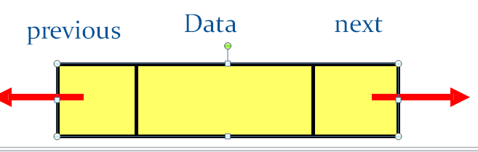
A doubly linked list contain three fields: an integer value, the link to the next node, and the link to the previous node.

Slide 32
DLL’s compared to SLL’s
Advantages:
Can be traversed in either direction (may be essential for some programs)
Some operations, such as deletion and inserting before a node, become easier
Disadvantages:
Requires more space
List manipulations are slower (because more links must be changed)
Greater chance of having bugs (because more links must be manipulated)

Slide 33
APPLICATIONS OF LINKED LIST
1.Applications that have an MRU list (a linked list of file names)
2.The cache in your browser that allows you to hit the BACK button (a linked list of URLs)
3.Undo functionality in Photoshop or Word (a linked list of state)
4.A stack, hash table, and binary tree can be implemented using a doubly linked list.

Slide 34
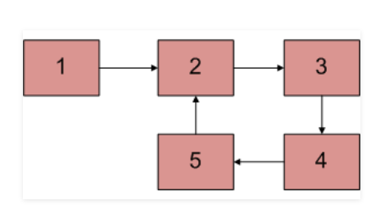
Here’s a question for all:-
How will we detect a loop in Single Linked List?

Slide 35
#include <bits/stdc++.h>
using namespace std;
class Node {
public:
int data;
Node* next;
};
void push(Node** head_ref, int new_data)
{
Node* new_node = new Node();
new_node->data = new_data;
new_node->next = (*head_ref);
(*head_ref) = new_node;
}

Slide 36
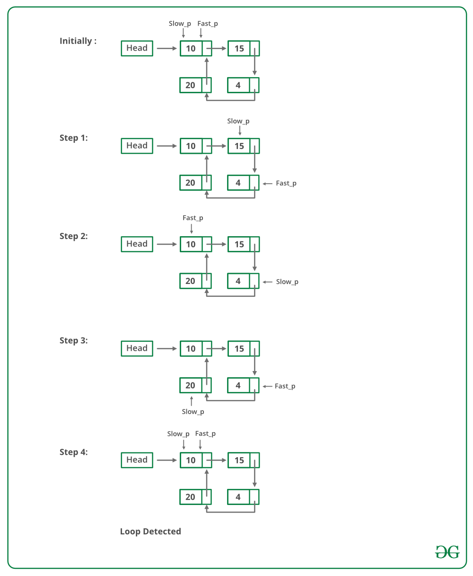
int detectloop(Node* list)
{
Node *slow_p = list, *fast_p = list;
while (slow_p && fast_p && fast_p->next) {
slow_p = slow_p->next;
fast_p = fast_p->next->next;
if (slow_p == fast_p) {
cout << "Found Loop";
return 1;
}
}
return 0;
}
int main()
{
/* Start with the empty list */
Node* head = NULL;
push(&head, 20);
push(&head, 4);
push(&head, 15);
push(&head, 10);
/* Create a loop for testing */
head->next->next->next->next = head;
detectloop(head);
return 0;
}

